Slide 1
Unemployment
© 2015 Cengage Learning. All Rights Reserved. May not be copied, scanned, or duplicated, in whole or in part, except for use as permitted in a license distributed with a certain product or service or otherwise on a password-protected website for classroom use.

Slide 2
Identifying Unemployment
Employed
  Those who worked
    Paid employees
    In their own business
    Unpaid workers in a family member’s business
  Full-time and part-time workers
  Temporarily absent
    Vacation, illness, bad weather
© 2015 Cengage Learning. All Rights Reserved. May not be copied, scanned, or duplicated, in whole or in part, except for use as permitted in a license distributed with a certain product or service or otherwise on a password-protected website for classroom use.

Slide 3
Identifying Unemployment
Unemployed
  Those who were not employed
    Available for work
    Tried to find employment during the previous four weeks
  Those waiting to be recalled to a job
    Laid off
© 2015 Cengage Learning. All Rights Reserved. May not be copied, scanned, or duplicated, in whole or in part, except for use as permitted in a license distributed with a certain product or service or otherwise on a password-protected website for classroom use.

Slide 4
Identifying Unemployment
Not in the labor force
  Not employed and not unemployed
  Full-time students
  Homemakers
  Retirees
© 2015 Cengage Learning. All Rights Reserved. May not be copied, scanned, or duplicated, in whole or in part, except for use as permitted in a license distributed with a certain product or service or otherwise on a password-protected website for classroom use.

Slide 5
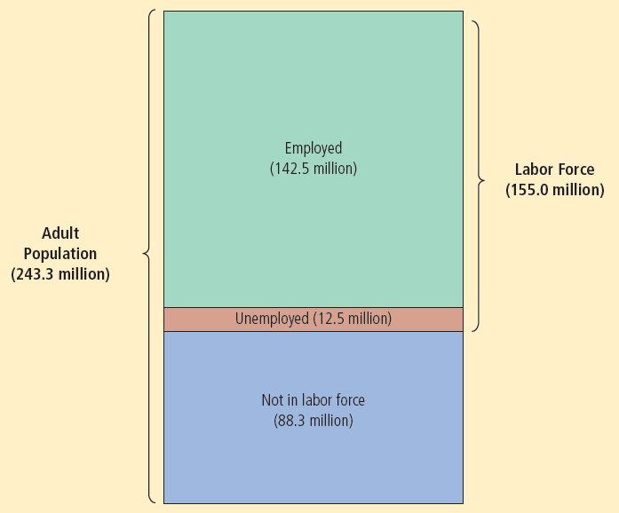

Figure 1
The Breakdown of the Population in 2012
The Bureau of Labor Statistics divides the adult population into three categories: employed, unemployed, and not in the labor force.
© 2015 Cengage Learning. All Rights Reserved. May not be copied, scanned, or duplicated, in whole or in part, except for use as permitted in a license distributed with a certain product or service or otherwise on a password-protected website for classroom use.

Slide 6
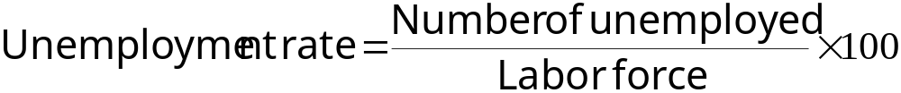
Identifying Unemployment
Labor force
  Total number of workers, employed and unemployed
  = Number of employed + Number of unemployed
Unemployment rate
  Percentage of labor force that is unemployed
© 2015 Cengage Learning. All Rights Reserved. May not be copied, scanned, or duplicated, in whole or in part, except for use as permitted in a license distributed with a certain product or service or otherwise on a password-protected website for classroom use.

Slide 7
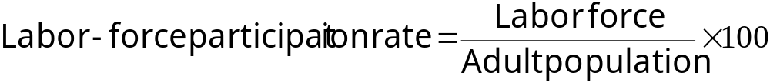
Identifying Unemployment
Labor-force participation rate
  Percentage of the total adult population that is in the labor force
  Fraction of the population that has chosen to participate in the labor market
© 2015 Cengage Learning. All Rights Reserved. May not be copied, scanned, or duplicated, in whole or in part, except for use as permitted in a license distributed with a certain product or service or otherwise on a password-protected website for classroom use.

Slide 8
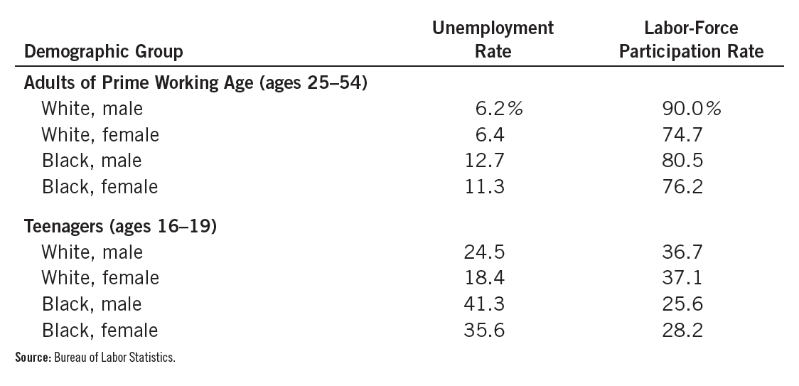
Table 1
The Labor-Market Experiences of Various Demographic Groups
This table shows the unemployment rate and the labor-force participation rate of various groups in the U.S. population for 2012.
© 2015 Cengage Learning. All Rights Reserved. May not be copied, scanned, or duplicated, in whole or in part, except for use as permitted in a license distributed with a certain product or service or otherwise on a password-protected website for classroom use.

Slide 9
Identifying Unemployment
Labor-market experiences
  Women of prime working age (25 to 54 years old)
    Lower rates of labor-force participation than men
  Once in the labor force
    Men and women - similar rates of unemployment
© 2015 Cengage Learning. All Rights Reserved. May not be copied, scanned, or duplicated, in whole or in part, except for use as permitted in a license distributed with a certain product or service or otherwise on a password-protected website for classroom use.

Slide 10
Identifying Unemployment
Labor-market experiences
  Blacks of prime working age
    Similar rates of labor-force participation as prime-age whites
    Much higher rates of unemployment
  Teenagers
    Lower rates of labor-force participation
    Much higher rates of unemployment than older workers
© 2015 Cengage Learning. All Rights Reserved. May not be copied, scanned, or duplicated, in whole or in part, except for use as permitted in a license distributed with a certain product or service or otherwise on a password-protected website for classroom use.

Slide 11
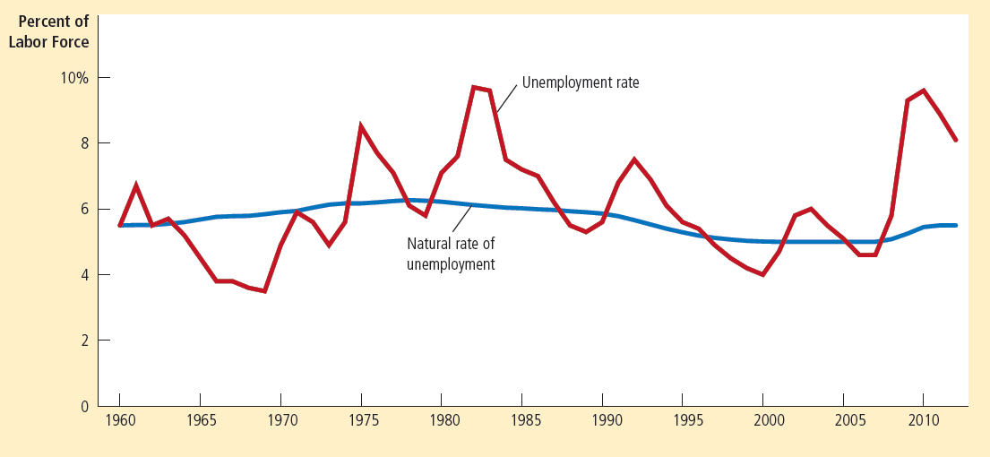

Figure 2
Unemployment Rate since 1960
This graph uses annual data on the U.S. unemployment rate to show the percentage of the labor force without a job. The natural rate of unemployment is the normal level of unemployment around which the unemployment rate fluctuates.
© 2015 Cengage Learning. All Rights Reserved. May not be copied, scanned, or duplicated, in whole or in part, except for use as permitted in a license distributed with a certain product or service or otherwise on a password-protected website for classroom use.

Slide 12
Identifying Unemployment
Natural rate of unemployment
  Normal rate of unemployment around which the unemployment rate fluctuates
  2012: 5.5% (well below the actual unemployment rate of 8.1%)
Cyclical unemployment
  Deviation of unemployment from its natural rate
© 2015 Cengage Learning. All Rights Reserved. May not be copied, scanned, or duplicated, in whole or in part, except for use as permitted in a license distributed with a certain product or service or otherwise on a password-protected website for classroom use.

Slide 13
Labor-force participation of men and women in the U.S. economy
Women’s role in American society
  Changed dramatically over the past century
  New technologies
    Reduced the amount of time required to complete routine household tasks
  Improved birth control
    Reduced the number of children born to the typical family
  Changing political and social attitudes
© 2015 Cengage Learning. All Rights Reserved. May not be copied, scanned, or duplicated, in whole or in part, except for use as permitted in a license distributed with a certain product or service or otherwise on a password-protected website for classroom use.

Slide 14
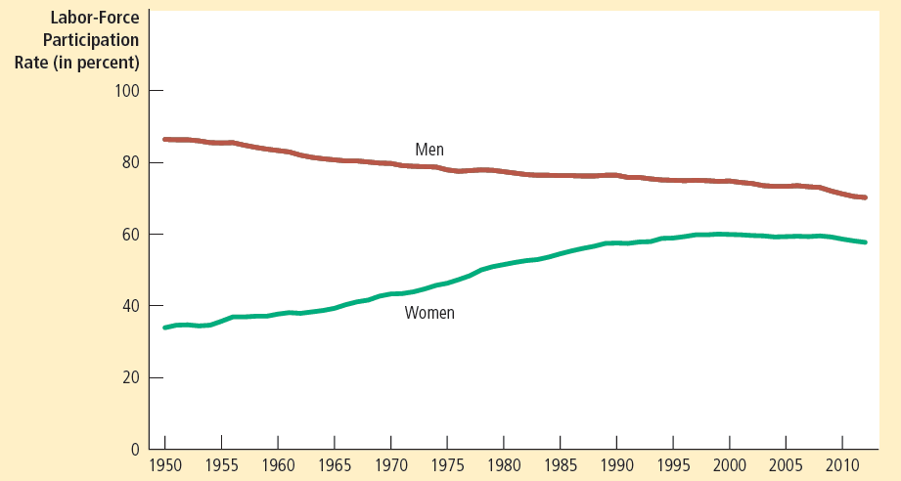

Figure 3
Labor-Force Participation Rates for Men and Women since 1950
This figure shows the percentage of adult men and women who are members of the labor force. Over the past several decades, women have entered the labor force, and men have left it.
© 2015 Cengage Learning. All Rights Reserved. May not be copied, scanned, or duplicated, in whole or in part, except for use as permitted in a license distributed with a certain product or service or otherwise on a password-protected website for classroom use.

Slide 15
Labor-force participation of men and women in the U.S. economy
Data on labor-force participation
1950 – difference between participation rates
  33% of women were working or looking for work
  87% of men were working or looking for work
© 2015 Cengage Learning. All Rights Reserved. May not be copied, scanned, or duplicated, in whole or in part, except for use as permitted in a license distributed with a certain product or service or otherwise on a password-protected website for classroom use.

Slide 16
Labor-force participation of men and women in the U.S. economy
2012 – difference between participation rates
  58% of women were working or looking for work
  70% of men were working or looking for work
© 2015 Cengage Learning. All Rights Reserved. May not be copied, scanned, or duplicated, in whole or in part, except for use as permitted in a license distributed with a certain product or service or otherwise on a password-protected website for classroom use.

Slide 17
Labor-force participation of men and women in the U.S. economy
Fall in men’s labor-force participation
  Young men stay in school longer
  Older men retire earlier and live longer
  With more women employed
    More fathers now stay at home to raise their children
Counted as being out of the labor force
  Full-time students, retirees
  Stay-at-home dads
© 2015 Cengage Learning. All Rights Reserved. May not be copied, scanned, or duplicated, in whole or in part, except for use as permitted in a license distributed with a certain product or service or otherwise on a password-protected website for classroom use.

Slide 18
Identifying Unemployment
Official unemployment rate
  Useful
  Imperfect measure of joblessness
Movements into and out of the labor force
  Common
  More than one-third of unemployed
    Recent entrants into the labor force
© 2015 Cengage Learning. All Rights Reserved. May not be copied, scanned, or duplicated, in whole or in part, except for use as permitted in a license distributed with a certain product or service or otherwise on a password-protected website for classroom use.

Slide 19
Identifying Unemployment
Unemployment
  Not all unemployment ends with the job seeker finding a job
    Half of all spells of unemployment end when the unemployed leaves the labor force
Some of those who report being unemployed
  May not be trying hard to find a job
    Want to qualify for a government help
    Working but paid “under the table”
© 2015 Cengage Learning. All Rights Reserved. May not be copied, scanned, or duplicated, in whole or in part, except for use as permitted in a license distributed with a certain product or service or otherwise on a password-protected website for classroom use.

Slide 20
Identifying Unemployment
Some of those who are out of labor force
  May want to work
    Discouraged workers
Discouraged workers
  Individuals who would like to work
  Have given up looking for a job
© 2015 Cengage Learning. All Rights Reserved. May not be copied, scanned, or duplicated, in whole or in part, except for use as permitted in a license distributed with a certain product or service or otherwise on a password-protected website for classroom use.

Slide 21
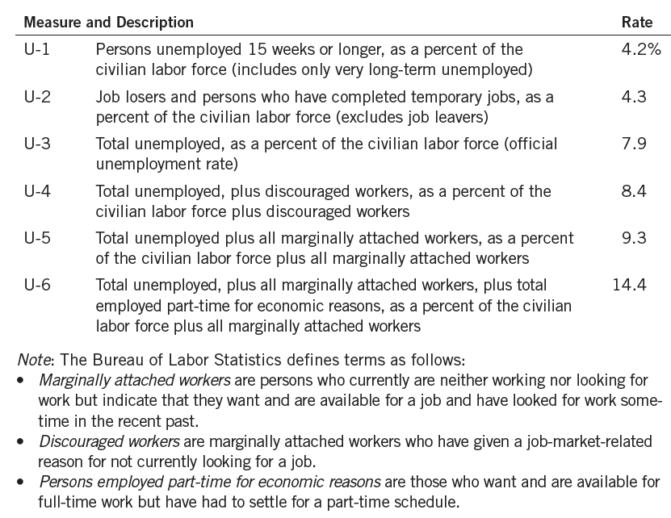

Table 2
Alternative Measures of Labor Underutilization
The table shows various measures of joblessness for the U.S. economy. The data are for January 2013.
© 2015 Cengage Learning. All Rights Reserved. May not be copied, scanned, or duplicated, in whole or in part, except for use as permitted in a license distributed with a certain product or service or otherwise on a password-protected website for classroom use.

Slide 22
Identifying Unemployment
How long are the unemployed without work?
  Most spells of unemployment are short
  Most unemployment observed at any given time is long-term
  Most people who become unemployed
    Will soon find jobs
© 2015 Cengage Learning. All Rights Reserved. May not be copied, scanned, or duplicated, in whole or in part, except for use as permitted in a license distributed with a certain product or service or otherwise on a password-protected website for classroom use.

Slide 23
Identifying Unemployment
How long are the unemployed without work?
  Most spells of unemployment are short, and most unemployment observed at any given time is long-term
  Most of the economy’s unemployment problem
    Attributable to the relatively few workers who are jobless for long periods of time
© 2015 Cengage Learning. All Rights Reserved. May not be copied, scanned, or duplicated, in whole or in part, except for use as permitted in a license distributed with a certain product or service or otherwise on a password-protected website for classroom use.

Slide 24
Identifying Unemployment
Unemployment rate
  Never falls to zero
  Fluctuates around the natural rate of unemployment
Frictional unemployment
  It takes time for workers to search for the jobs that best suit their tastes and skills
  Explain relatively short spells of unemployment
© 2015 Cengage Learning. All Rights Reserved. May not be copied, scanned, or duplicated, in whole or in part, except for use as permitted in a license distributed with a certain product or service or otherwise on a password-protected website for classroom use.

Slide 25
Identifying Unemployment
Structural unemployment
  Results because the number of jobs available in some labor markets
    Is insufficient to provide a job for everyone who wants one
  Explains longer spells of unemployment
  Results when wages are set above the equilibrium
    Minimum-wage laws, unions, and efficiency wages
© 2015 Cengage Learning. All Rights Reserved. May not be copied, scanned, or duplicated, in whole or in part, except for use as permitted in a license distributed with a certain product or service or otherwise on a password-protected website for classroom use.

Slide 26
Job Search
Job search
  Process by which workers find appropriate jobs given their tastes and skills
    Workers differ in their tastes and skills
    Jobs differ in their attributes
    Information about job candidates and job vacancies is disseminated slowly
© 2015 Cengage Learning. All Rights Reserved. May not be copied, scanned, or duplicated, in whole or in part, except for use as permitted in a license distributed with a certain product or service or otherwise on a password-protected website for classroom use.

Slide 27
Job Search
Some frictional unemployment is inevitable
  Changes in demand for labor among different firms
  Changes in composition of demand among industries or regions (sectoral shifts)
  The economy is always changing
    Jobs created in some firms
    Jobs destroyed in other firms
© 2015 Cengage Learning. All Rights Reserved. May not be copied, scanned, or duplicated, in whole or in part, except for use as permitted in a license distributed with a certain product or service or otherwise on a password-protected website for classroom use.

Slide 28
Public Policy and Job Search
Reduce time for unemployed to find jobs
  Reduce natural rate of unemployment
Government programs – to facilitate job search
  Government-run employment agencies
  Public training programs
© 2015 Cengage Learning. All Rights Reserved. May not be copied, scanned, or duplicated, in whole or in part, except for use as permitted in a license distributed with a certain product or service or otherwise on a password-protected website for classroom use.

Slide 29
Public Policy and Job Search
Unemployment insurance
  Government program
  Partially protects workers’ incomes
    When they become unemployed
  Increases frictional unemployment
    Without intending to do so
  Qualify – only the unemployed who were laid off because their previous employers no longer needed their skills
© 2015 Cengage Learning. All Rights Reserved. May not be copied, scanned, or duplicated, in whole or in part, except for use as permitted in a license distributed with a certain product or service or otherwise on a password-protected website for classroom use.

Slide 30
Public Policy and Job Search
Unemployment insurance
  50% of former wages for twenty-six weeks
  Reduces the hardship of unemployment
  Increases the amount of unemployment
    Unemployment benefits stop when a worker takes a new job
    Unemployed
      Devote less effort to job search
      More likely to turn down unattractive job offers
      Less likely to seek guarantees of job security
© 2015 Cengage Learning. All Rights Reserved. May not be copied, scanned, or duplicated, in whole or in part, except for use as permitted in a license distributed with a certain product or service or otherwise on a password-protected website for classroom use.

Slide 31
Minimum-Wage Laws
Structural unemployment
  Number of jobs – insufficient
Minimum-wage laws
  Can cause unemployment
  Forces the wage to remain above the equilibrium level
    Higher quantity of labor supplied
    Smaller quantity of labor demanded
    Surplus of labor = unemployment
© 2015 Cengage Learning. All Rights Reserved. May not be copied, scanned, or duplicated, in whole or in part, except for use as permitted in a license distributed with a certain product or service or otherwise on a password-protected website for classroom use.

Slide 32
Figure 4
Unemployment from a Wage above the Equilibrium Level
Wage
Surplus of labor = Unemployment
Labor
supply
Minimum wage
W_{E}
Labor
demand
0
L_{D}
L_{E}
L_{S}
Quantity of Labor
In this labor market, the wage at which supply and demand balance is W_{E}. At this equilibrium wage, the quantity of labor supplied and the quantity of labor demanded both equal L_{E}. By contrast, if the wage is forced to remain above the equilibrium level, perhaps because of a minimum-wage law, the quantity of labor supplied rises to L_{S}, and the quantity of labor demanded falls to L_{D}. The resulting surplus of labor, L_{S} – L_{D}, represents unemployment.
© 2015 Cengage Learning. All Rights Reserved. May not be copied, scanned, or duplicated, in whole or in part, except for use as permitted in a license distributed with a certain product or service or otherwise on a password-protected website for classroom use.

Slide 33
Minimum-Wage Laws
Wages may be kept above equilibrium level
  Minimum-wage laws
  Unions
  Efficiency wages
If the wage is kept above the equilibrium level
  Result: unemployment
© 2015 Cengage Learning. All Rights Reserved. May not be copied, scanned, or duplicated, in whole or in part, except for use as permitted in a license distributed with a certain product or service or otherwise on a password-protected website for classroom use.

Slide 34
Unions & Collective Bargaining
Union
  Worker association
  Bargains with employers over
    Wages, benefits, and working conditions
  11% of U.S. workers
  Type of cartel
© 2015 Cengage Learning. All Rights Reserved. May not be copied, scanned, or duplicated, in whole or in part, except for use as permitted in a license distributed with a certain product or service or otherwise on a password-protected website for classroom use.

Slide 35
Unions & Collective Bargaining
Collective bargaining
  Process by which unions and firms agree on the terms of employment
Strike
  Organized withdrawal of labor from a firm by a union
  Reduces production, sales, and profit
Union workers
  Earn 10-20% more than similar workers who do not belong to unions
© 2015 Cengage Learning. All Rights Reserved. May not be copied, scanned, or duplicated, in whole or in part, except for use as permitted in a license distributed with a certain product or service or otherwise on a password-protected website for classroom use.

Slide 36
Unions & Collective Bargaining
Union - raises the wage above the equilibrium level
  Higher quantity of labor supplied
  Smaller quantity of labor demanded
  Unemployment
  Better off: employed workers (insiders)
  Worse off: unemployed (outsiders)
    May stay unemployed
    Take jobs in firms that are not unionized
© 2015 Cengage Learning. All Rights Reserved. May not be copied, scanned, or duplicated, in whole or in part, except for use as permitted in a license distributed with a certain product or service or otherwise on a password-protected website for classroom use.

Slide 37
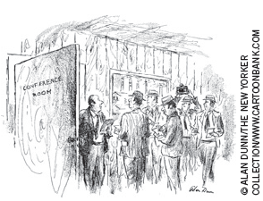
Unions & Collective Bargaining
Union - raises the wage above equilibrium
  Supply of labor in industries not unionized will increase, lower wages
Workers in unions
  Reap the benefit of collective bargaining
Workers not in unions
  Bear some of the cost
“Gentle men, nothing stands in the way of a final accord except that management wants profit maximization and the union wants more moola.”
© 2015 Cengage Learning. All Rights Reserved. May not be copied, scanned, or duplicated, in whole or in part, except for use as permitted in a license distributed with a certain product or service or otherwise on a password-protected website for classroom use.

Slide 38
Unions & Collective Bargaining
Are unions good or bad for the economy?
  Critics
    Unions - a type of cartel
    Allocation of labor
      Inefficient - high union wages reduce employment in unionized firms below the efficient level
      Inequitable - some workers benefit at the expense of other workers
© 2015 Cengage Learning. All Rights Reserved. May not be copied, scanned, or duplicated, in whole or in part, except for use as permitted in a license distributed with a certain product or service or otherwise on a password-protected website for classroom use.

Slide 39
Unions & Collective Bargaining
Are unions good or bad for the economy?
  Advocates
    Unions - necessary antidote to the market power of the firms that hire workers
      In the absence of a union, firms pay lower wages and offer worse working conditions
    Unions - help firms respond efficiently to workers’ concerns
      Keep a happy and productive workforce
© 2015 Cengage Learning. All Rights Reserved. May not be copied, scanned, or duplicated, in whole or in part, except for use as permitted in a license distributed with a certain product or service or otherwise on a password-protected website for classroom use.

Slide 40
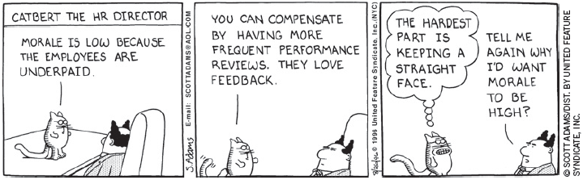
Theory of Efficiency Wages
Efficiency wages
  Above-equilibrium wages paid by firms to increase worker productivity
    Worker health; Worker turnover
    Worker quality; Worker effort
© 2015 Cengage Learning. All Rights Reserved. May not be copied, scanned, or duplicated, in whole or in part, except for use as permitted in a license distributed with a certain product or service or otherwise on a password-protected website for classroom use.

Slide 41
Theory of Efficiency Wages
Worker health
  Better paid workers
    Eat a more nutritious diet
    Healthier and more productive
Worker turnover
  Firm - can reduce turnover among its workers
    By paying them a high wage
© 2015 Cengage Learning. All Rights Reserved. May not be copied, scanned, or duplicated, in whole or in part, except for use as permitted in a license distributed with a certain product or service or otherwise on a password-protected website for classroom use.

Slide 42
Theory of Efficiency Wages
Worker quality
  Firm – pays a high wage
    Attracts a better pool of workers
    Increases the quality of its workforce
Worker effort
  High wages – make workers more eager to keep their jobs
    Give workers an incentive to put forward their best effort
© 2015 Cengage Learning. All Rights Reserved. May not be copied, scanned, or duplicated, in whole or in part, except for use as permitted in a license distributed with a certain product or service or otherwise on a password-protected website for classroom use.

Slide 43
Henry Ford and the very generous
$5-a-day wage
Henry Ford, founder of Ford Motor Company
  Introduced modern techniques of production
  Built cars on assembly lines
    Unskilled workers were taught to perform the same simple tasks over and over again
  Output: Model T Ford
© 2015 Cengage Learning. All Rights Reserved. May not be copied, scanned, or duplicated, in whole or in part, except for use as permitted in a license distributed with a certain product or service or otherwise on a password-protected website for classroom use.

Slide 44
Henry Ford and the very generous
$5-a-day wage
1914, Ford: the $5 workday
  Twice the going wage
  Long lines of job seekers
    Number of workers willing to work > number of workers Ford needed
Ford’s high-wage policy: efficiency wage
© 2015 Cengage Learning. All Rights Reserved. May not be copied, scanned, or duplicated, in whole or in part, except for use as permitted in a license distributed with a certain product or service or otherwise on a password-protected website for classroom use.

Slide 45
Henry Ford and the very generous
$5-a-day wage
Ford’s efficiency wage
  Turnover fell
  Absenteeism fell
  Productivity rose
  Workers – so much more efficient
    Ford’s production costs were lower despite higher wages
  Profitable for the firm
© 2015 Cengage Learning. All Rights Reserved. May not be copied, scanned, or duplicated, in whole or in part, except for use as permitted in a license distributed with a certain product or service or otherwise on a password-protected website for classroom use.

Slide 46
Henry Ford and the very generous
$5-a-day wage
Ford’s efficiency wage
  High worker effort
  Closely linked to Ford’s use of the assembly line
    Assembly line - highly interdependent workers
© 2015 Cengage Learning. All Rights Reserved. May not be copied, scanned, or duplicated, in whole or in part, except for use as permitted in a license distributed with a certain product or service or otherwise on a password-protected website for classroom use.

